Slide 1
Versioning of Classes in the Harmonized Model
C Douglas O’Brien
WG6 Convenor
10 June 2015

Slide 2
Need for Versioning
As the suite of TC211 standards is revised there are becoming multiple versions of the same class in the model.
Since names are reused in different packages it is very difficult to determine which version of a class is being referenced.
Even the dates are not sufficient to distinguish classes since the dates are not consistant.

Slide 3
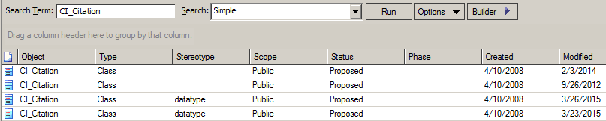
Searching for a class
The following is the result for a search on the class CI_Citation.
Which version is the latest, and which is the one that should be referenced (not necessarily the latest).
One cannot depend upon the dates. Often there are many classes with the same dates, and any modification even sometimes cleaning-up an old class layout in a diagram can change the dates.

Slide 4
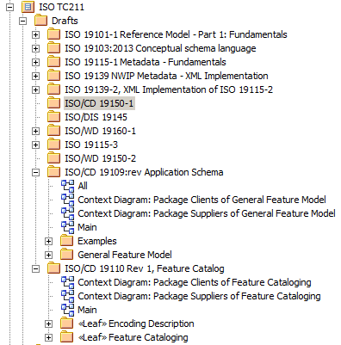
Package Names
The packages are intended to keep the names of classes unique, but some classes are in funny paths such as a CD subpackage that has never been promoted to be a final version.
Although clearly marked as a draft in the project browser, it is not possible to tell from the reference.

Slide 5
Status flags
EA has some nice filters, one of which is on the status of a class.
This doesn't seem to have been used consistently.
The status parameter should be "adopted" when the standard defining the class is adopted as an IS or TS. Up to then it should be proposed.
This would allow one to filter and select only adopted classes.
There should be only one adopted class for each adopted version of a standard; that is, a class may be defined in 19115:2003 and redefined in 19115:2006 (corrigendum). The same class may be redefined in 19115-1:2014. There might be three clearly distinct adopted versions of the class from three adopted sources.
Right now there are also intermediate draft versions in the model that one would like to be able to filter out.

Slide 6
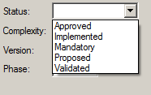
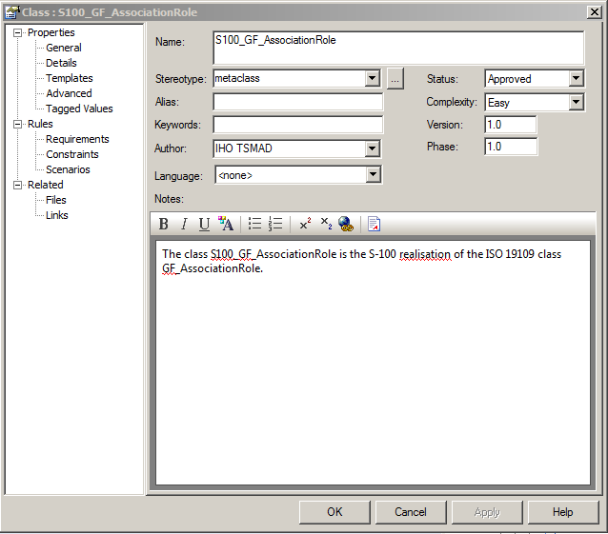
EA Class Status Attributes
The Status, Author, Version and Phase attributes should be consistently populated.
EA allows the status
In ISO the version could be the year of pub, and phase the ISO phase code
All classes should be documented
Since this is a data model not a software implementation model the “language” attribute should be populated as <none>.

Slide 7
Using the Status Flags
A parameter in EA that might be useful is the "author" parameter for a class.
Right now it seems to be either blank or the name of the person who modeled the class. This is fine for drafts; however, when a class is finally "adopted" the name of the author should be the standard name from which it is representative.
That is, the class from ISO 19115:2003 would have as an author ISO19115_2003, which would distinguish it from the redefined class in ISO19115_2006 or ISO19115-1_2014.
If one does a model search on the class name with the filter set to "adopted" then one should get three classes each clearly identified as to where they are representative of.

Slide 8
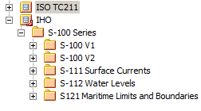
Organizing models by version
Standards may be organized by publication date as in ISO or by version.
Both are valid approaches.
Organizing by date of publication means that the tree of relations must be maintained.
Sometimes the latest version is not the correct version to reference.

Slide 9
Orphan Notes
EA has no properties on notes so it can be a task to trace all links to find where a note is sourced.
Therefore notes should not be shared.
If one copies a class to generate a new class the notes are shared unless the class is copied as new.

Slide 10
Tracing classes
Some classes do not trace back to the original source. That is, a class in a revised standard may not carry all the relations that were defined in the original standard.
If the relations were dropped on purpose, then this is correct, but some just seem to have been forgotten.
A really good practise would be to create a lineage diagram for each class that is redefined in a new standard indicating its relationship to the previous version of the class.
This lineage diagram might not show in the standard, but it would be useful in the model.
One could trace a class and its predecessors.

Slide 11
Traceability in IHO S-100
In S-100 V2 All classes use the versioning tags Version and Phase.
All classes in the Version 1 package are labeled as Phase 1 and all classes in the Version 2 package are labeled as Phase 2.
All classes in Version 1 are labeled as Version 1.
Classes in Version 2 that are identical to the classes in Version 1 (including having the same relations) are labeled as Version 1 defined classes.
All classes in Version 2 that are new or have changed from Version 1 are labeled as being Version 2 classes.
A <trace> relationship is established between classes in the Version 2 package back to class in the Version 1 package that is either equivalent or is the base class for the change in Version 2.

Slide 12
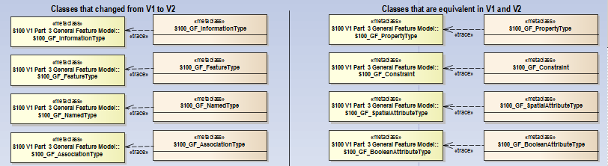

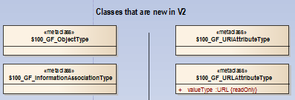
Trace Diagram
Trace is a real relationship between classes in one package to another.
…
…
…

Slide 13
Referencing different versions
What one finds in IHO S-100 is that this suite of standards (with multiple parts, and multiple standards) references classes in ISO TC211 model at different times and versions.
The parts of S-100 should fit if the parts of ISO fit, but errors, especially the hidden errors, propagate.
It would be nice to reference the latest version of any class after checking the lineage to ensure that nothing substantive has changes.
If there are reasons that an older version of a class will need to be referenced, where possible we can describe the reason.
For example, the data quality part of S-100 references 19138. ISO 19157 does things differently, and an explanation is needed to change to 19157.
The change to reference 19157 won’t occur until S-100 V3, but data complying to S-100 V1 will remain in use until past 2035.

Slide 14
Naming classes
In the harmonized model packages should be named with their year.
This is done for metadata 19115 and spatial referencing 19111 (for part 2) and some others.
A series of standards should have a package named for the whole group ISO 19111 or ISO 19115 or ISO 19144 containing all the parts and versions with dates in the names of the parts and versions.
The names should be file system safe (windows, Mac and Linux) with an underline not a colon even though EA allows a colon.

